Slide 1

Term Project DSC 530
Abed Tabbalat

Slide 2
Summary
This project is created to analyze insurance data between premiums, reinsurance premiums, and losses to determine if there are any relationships that can trigger investigations on how to improve certain products.
The following will be discussed
Packages
Data imports & reformat
Histograms per variable
PMF exhibit
CDF exhibit
Lognormal Model for an analytical distribution
Scatter Plot exhibit
Covariance, Correlation, & Spearman Correlation
Permutation Test
Linear Regression

Slide 3
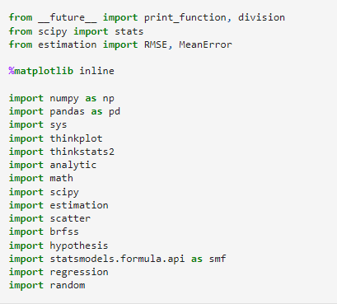
Packages

Slide 4
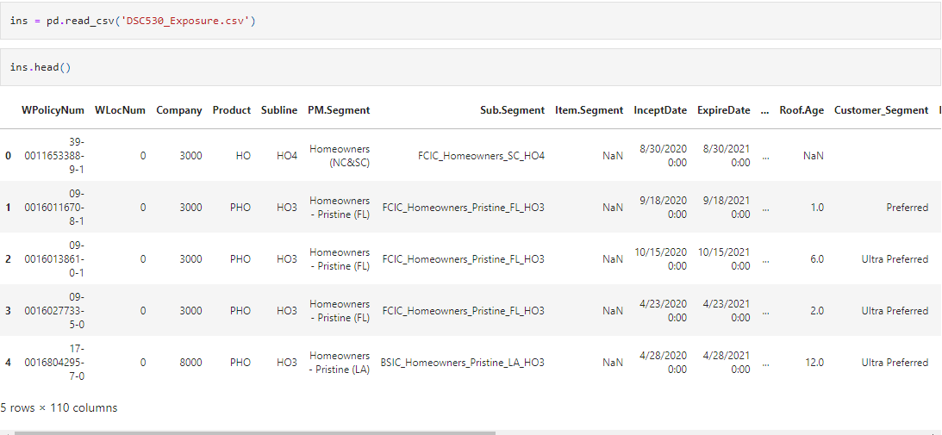
Data Imports
Data has been imported from a CSV file containing 110 columns as shown below.

Slide 5
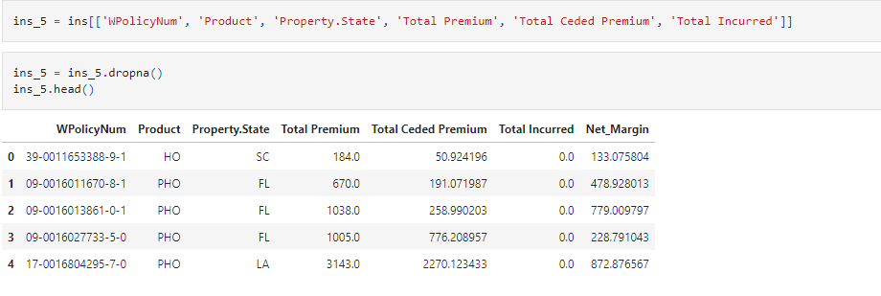
Data Reformat
We will be focusing on 5 main variables which are: Product, State, Total Premium, Total Ceded Premium, Total Incurred Losses

Slide 6
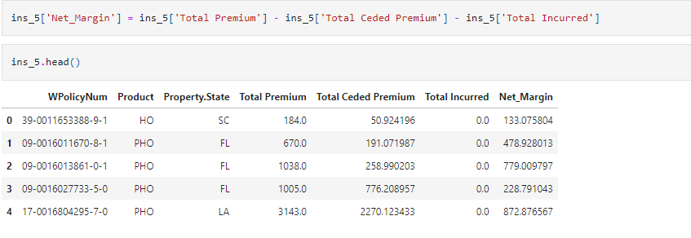
Data Reformat (Continued)
Net Margin will be the 6th variable added by computing Premiums LESS Ceded LESS Incurred Loss

Slide 7
Data Reformat (Continued)
Net Margin will be the 6th variable added by computing Premiums LESS Ceded LESS Incurred Loss

Slide 8
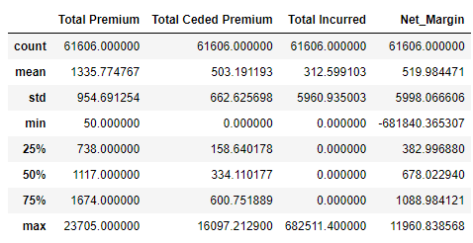
Variable Mean

Slide 9
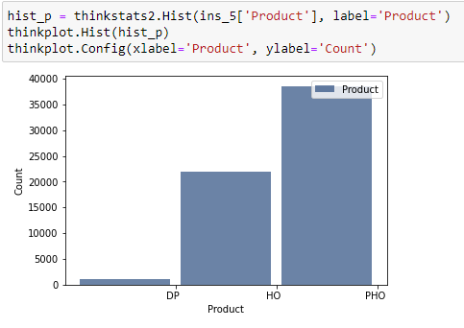
Histogram Product
Histogram below shows that PHO product has the most amount of policies, this histogram would not identify any outliers.

Slide 10
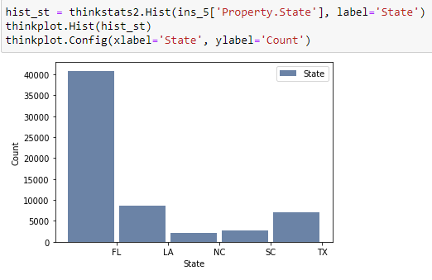
Histogram State
This histogram shows that the state of FL holds the most number of policies in the company.

Slide 11
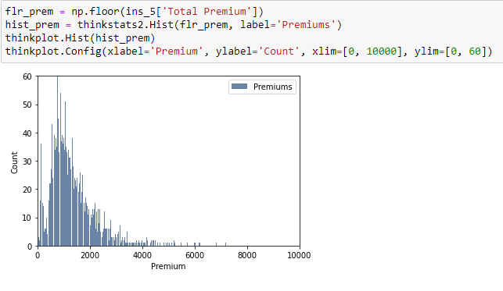
Histogram Premiums
There are a few outliers that I am observing which are high end homes with high amount of premiums that we can observe right below the 7,000 mark.

Slide 12
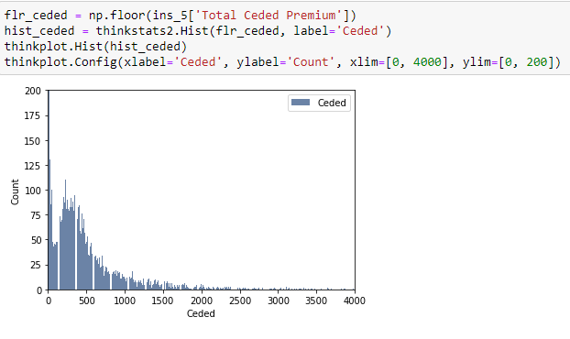
Histogram Ceded Premiums
The main outlier in the ceded are the policies that are not subject to any reinsurance contract, hence we can see the highest count forms the policies that aren't counted.

Slide 13
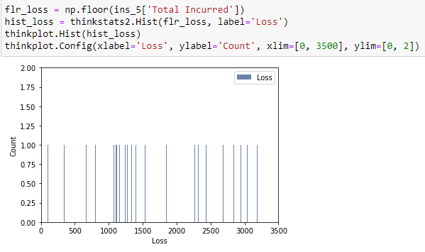
Histogram Losses
This makes sense for losses as this is showing the count per policy on the amount of losses, since the data is in a chunk of a period of time, a policy can only file one claim and the amount of claims paid would move based on the loss amount.

Slide 14
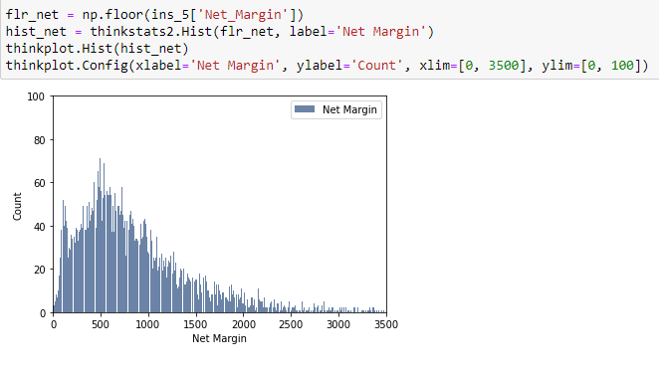
Histogram Net Margin
Outliers here are going to be the policies that are not subject to reinsurance and have no losses which can show full profit from the premium. Most of the policies that are in the average of losses and reinsurance will profit about 500 per policy.

Slide 15
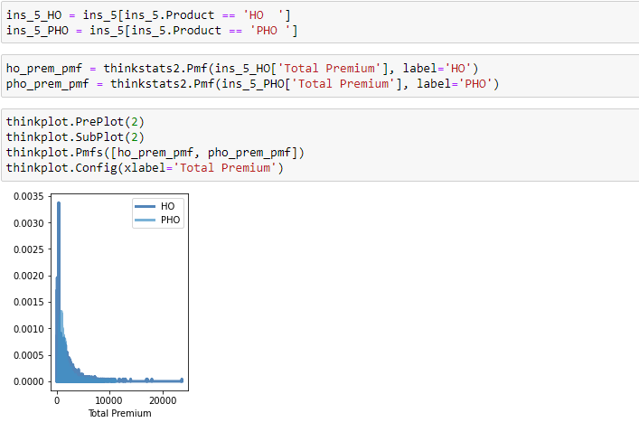
PDFs
Will attempt a PMF on Total Premium between the Products HO and PHO.

Slide 16
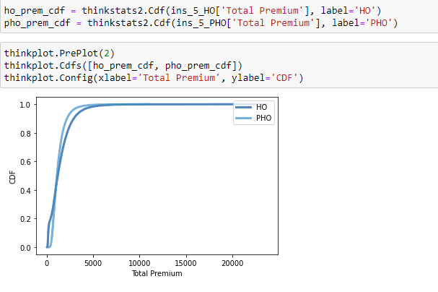
CDFs
Will attempt a CDF on Total Premium between the Products HO and PHO.

Slide 17
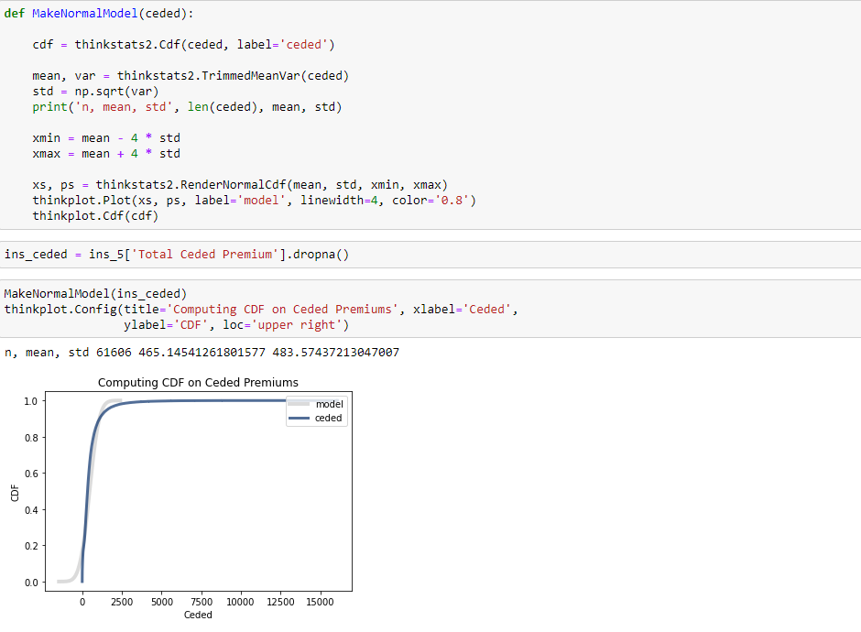
Lognormal Model on Ceded Premiums
The model is a good fit for the data, meaning every policy that gets issued will cede a portion of it.

Slide 18
Lognormal Model on Ceded Premiums
The model is a good fit for the data, meaning every policy that gets issued will cede a portion of it.

Slide 19
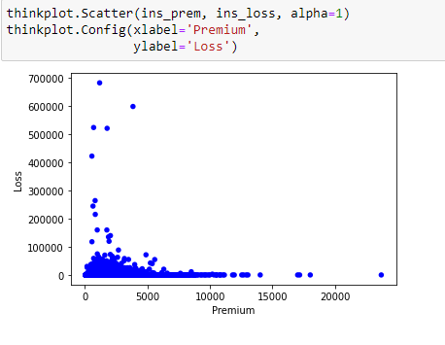
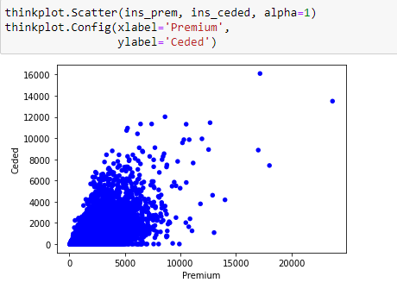
Scatter Plots
Premiums vs Losses
Premiums vs Ceded Premiums

Slide 20
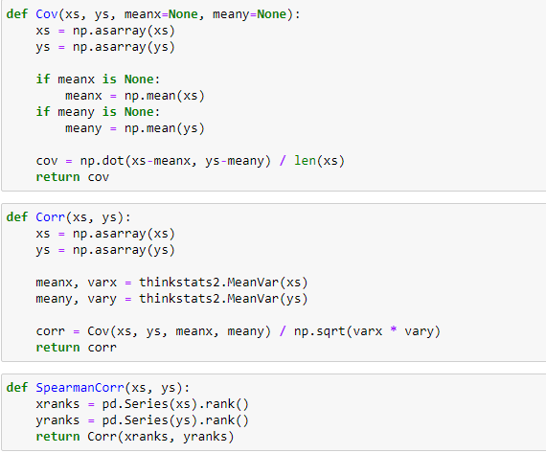
Covariance, Correlation, & Spearman Correlation
These are the functions that will be used to compute all 3 components

Slide 21
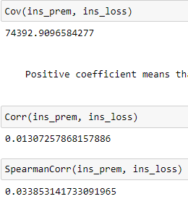
Covariance, Correlation, and Spearman Correlation on Premiums vs Losses
Positive coefficient means that more premiums we get, more losses will happen.
The covariance stated that a positive coefficient stating if premiums increase, losses will do the same. However, after running a correlation test and Spearman's correlation test, the result is 0.013 which is close to zero. Meaning, they're having more or less premiums doesn't mean that losses will happen. This makes sense as a company can have a year where they are shrinking and having a bad weather year causing so many losses to occur. Or, growing the premiums where that year had no weather impacts that could affect those policies as much.

Slide 22
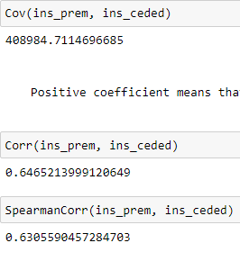
Covariance, Correlation, and Spearman Correlation on Premiums vs Ceded Premiums
Positive coefficient means that more premiums we get, more premium will be given to the reinsurer.
Correlation and Spearman's Correlation states that there is a positive relationship between premiums and what are given to the reinsurer. This makes sense because depending on the contract (and there could be more than one contract in place) the more premiums we are writing the more we are giving the reinsurer to protect us from exposure. Now the reason that the relationship isn't a full 1 is because some contracts would require a fixed monthly fee as opposed to others that are ceding a percentage of the premium. In addition, some policies maybe not subject to reinsurers which is also another factor.

Slide 23
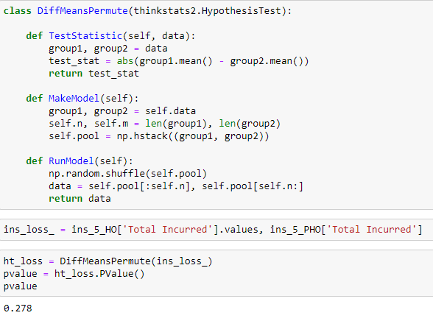
Permutation Test on Losses
P value came at 27.8% which is plausible that the observed difference is the result from random sampling.

Slide 24
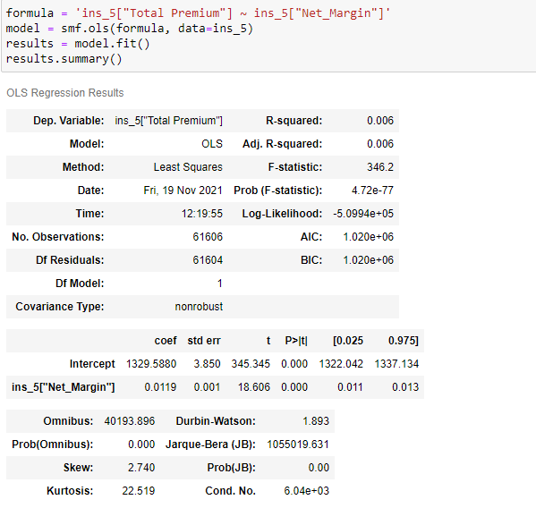
Linear Regression on Premiums vs Margin

